Slide 1

Introduction to Python
Speaker Nikhi Shah’’

Slide 2
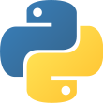
What is Python?
Python is a popular high-level programming language used in various applications
Python is an easy language to learn because of its simple syntax
Python can be used for simple tasks such as plotting or for more complex tasks like machine learning

Slide 3
Today, Python is one of the most popular programming languages. Although it is a general-purpose language, it is used in various areas of applications such as Machine Learning, Artificial Intelligence, web development, IoT, and more.
Python is a very popular general-purpose interpreted, interactive, object-oriented, and high-level programming language. Python is dynamically-typed and garbage-collected programming language. It was created by Guido van Rossum during 1985- 1990. Like Perl, Python source code is also available under the GNU General Public License (GPL).

Slide 4
Python supports multiple programming paradigms, including Procedural, Object Oriented and Functional programming language. Python design philosophy emphasizes code readability with the use of significant indentation.

Slide 5
Python is Open Source which means its available free of cost.
Python is simple and so easy to learn
Python is versatile and can be used to create many different things.
Python has powerful development libraries include AI, ML etc.
Python is much in demand and ensures high salary

Slide 6
Python is Interpreted − Python is processed at runtime by the interpreter. You do not need to compile your program before executing it. This is similar to PERL and PHP.
Python is Interactive − You can actually sit at a Python prompt and interact with the interpreter directly to write your programs.
Python is Object-Oriented − Python supports Object-Oriented style or technique of programming that encapsulates code within objects.
Python is a Beginner's Language − Python is a great language for the beginner-level programmers and supports the development of a wide range of applications from simple text processing to WWW browsers to games.

Slide 7
It supports functional and structured programming methods as well as OOP.
It can be used as a scripting language or can be compiled to byte-code for building large applications.
It provides very high-level dynamic data types and supports dynamic type checking.
It supports automatic garbage collection.
It can be easily integrated with C, C++, COM, ActiveX, CORBA, and Java.
Applications of Python….

Slide 8
Easy-to-learn − Python has few keywords, simple structure, and a clearly defined syntax. This allows the student to pick up the language quickly.
Easy-to-read − Python code is more clearly defined and visible to the eyes.
Easy-to-maintain − Python's source code is fairly easy-to-maintain.
A broad standard library − Python's bulk of the library is very portable and cross-platform compatible on UNIX, Windows, and Macintosh.
Interactive Mode − Python has support for an interactive mode which allows interactive testing and debugging of snippets of code.

Slide 9
Portable − Python can run on a wide variety of hardware platforms and has the same interface on all platforms.
Extendable − You can add low-level modules to the Python interpreter. These modules enable programmers to add to or customize their tools to be more efficient.
Databases − Python provides interfaces to all major commercial databases.
GUI Programming − Python supports GUI applications that can be created and ported to many system calls, libraries and windows systems, such as Windows MFC, Macintosh, and the X Window system of Unix.

Slide 10
Variables, Objects, and Classes
A variable is a reference to a value stored in a computer’s memory.
Variables can be sorted into a variety of categories (or data types) such as numbers (int/float etc), Boolean values (true/false), and sequences (strings, lists etc).
An object is a collection of data from a computer’s memory that can be manipulated.
ALL VARIABLES ARE OBJECTS although some objects can be defined by data referred to by multiple variables.
Methods are the functions used to act on/alter an object’s data. They describe what your object can “do.”

Slide 11
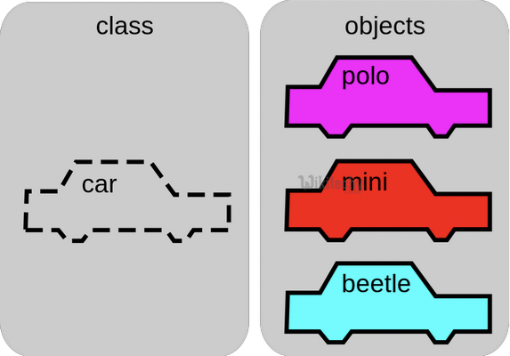
Variables, Objects, and Classes (cont.)
A class is a collection of objects who share the same set of variables/methods.
The definition of the class provides a blueprint for all the objects within it (instances).
Instances may share the same variables (color, size, shape, etc.), but they do NOT share the same values for each variable (blue/red/pink, small/large, square/circular etc.)
Instance #1
Color: Pink
Name: Polo
Instance #2
Color: Red
Name: Mini
Instance #3
Color: Blue
Name: Beetle

Slide 12
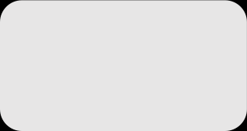
Basic Syntax Rules
The name of your variable (myInt etc.) is placed on the left of the “=“ operator.
Most variable names are in camel case where the first word begins with a lowercase letter and any subsequent words are capitalized
Variable names may also appear in snake case where all words are lowercase, with underscores between words
The assignment operator (“=“) sets the variable name equal to the memory location where your value is found.
The value of your variable (“Hello, World”) is placed on the right of the “=“ operator.
The type of this value does NOT need to be stated but its format must abide by a given object type (as shown).
myString = “Hello, World” myInt = 7 myFloat = 7.0 myList = [7, 8, 9] myBoolean = true

Slide 13
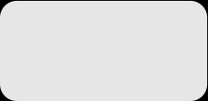
Basic Syntax Rules
Function Syntax
def...: indicates that you are defining a new function.
function() refers to the name of your function. By convention, this name is typically lowercase and represents a verb/action.
a,b refers to parameters (values or variables) that can be used within the statements of your function’s definition (......). If your function has no parameters, an empty parenthetical () is used.
The return statement is an optional statement that will return a value for your function to your original call.
def function(a, b):
......
return a + b

Slide 14

Basic Syntax Rules (cont.)
Calling a function
Call the function by referring to its name (function()) and by placing any necessary arguments (1, 2) within the parenthesis separated by commas. myValue = function(1, 2)
If you wish, you can set your function call equal to a variable (myValue). The value returned by the function will be assigned to your variable name.
myValue = function(1, 2)

Slide 15
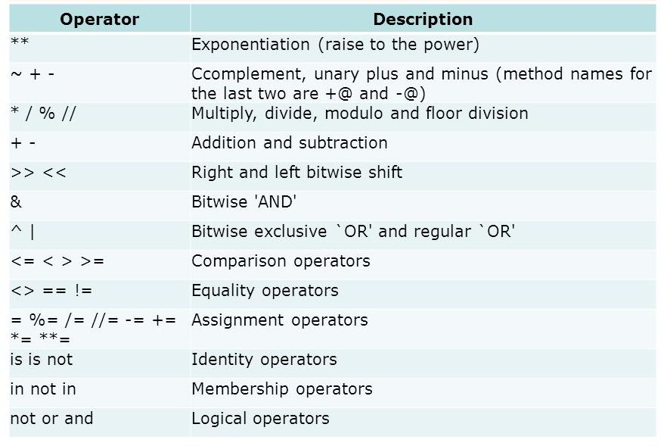
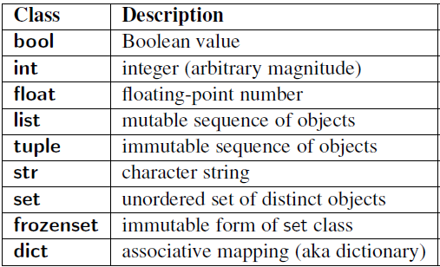
Common Data Types and Operators
A data type is a means of classifying a value and determining what operations can be performed on it. All objects have a data type.
Operators are symbols used carry out specific functions/computations.
https://www.youtube.com/watch?v=v5MR5JnKcZI

Slide 16
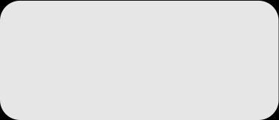
Input/Output
Input functions (input()) allow users of a program to place values into programming code.
The parameter for an input function is called a prompt. This is a string (this can be indicated by “” or ‘’) such as “Enter a number: “
The user’s response to the prompt will be returned to the input statement call as a string. To use this value as any other data type, it must be converted with another function (int()).
Print functions (print()) allow programs to output strings to users on a given interface.
The parameter of this function is of any type. All types will automatically be converted to strings.
xString = input(“Enter a number: “)
x = int(xString) y=x+2 print(y)

Slide 17

If-else Statements
If-else statements allow programmers to adapt the function of their code based on a given condition.
If a given condition (i.e. x % 2 == 0) is true, then the statements following the if statement (if) will be executed. If the condition is false, the statements following the else statement (else) will be executed.
The condition is tested using the Boolean operators == (is equal to), != (is not equal to), and (used to test multiple conditions), and or (used to test if AT LEAST ONE condition is true).
Additionally, else-if statements (elif) can be used to provide unique coding statements for multiple conditions.
xString = input(“Enter a number: “)
x = int(xString)
if x % 2 == 0: print(“This is an even number”)
elif x == 0: print(“This number equals 0”)
else:
print(“This is an odd number”)

Slide 18

For Loops
For loops perform the same task (iterate) for the number of times specified by an iterable (something that can be evaluated repeatedly such as a list, string, or range).
for defines the for loop
x is the variable defining the number of times the statements within the loop (print(myInt)) are executed.
The range(start, stop, step) function is often used to define x.
The starting value is defined by start, the final value is defined by stop – 1, and the magnitude at which x changes between loops is defined by step.
in is a Boolean operator that returns true if the given value (x) is found within a given list, string, range etc.
myString = input(“Enter a number: “)
myInt = int(myString)
for x in range(0, 5, 1): print(myInt)

Slide 19

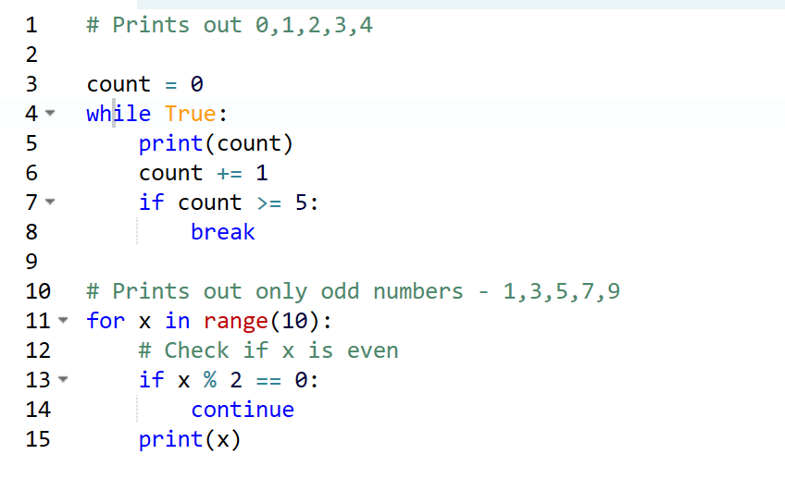
While Loops
myString = input(“Enter a number: “)
myInt = int(myString)
x = 0 while x < 5:
print(myInt)
x= x +1
While loops are statements that iterate so long as a given Boolean condition is met.
x (the variable determining whether or not the condition is met) is defined and manipulated OUTSIDE of the header of the while loop (while)
The condition (x < 5) is a statement containing a Boolean variable.
break is a statement used to exit the current for/while loop.
continue is a statement used to reject all statements in the current for/while loop iteration and return to the beginning of the loop.

